Slide 1
Handwritten Equation Recognizer
CAB420 – Machine Learning
Final project
William Jussiau
Johnson Loh
David Schmidt

Slide 2
Introduction
Data acquisition and pre-processing
Clustering
Classification
Demonstration

Slide 3
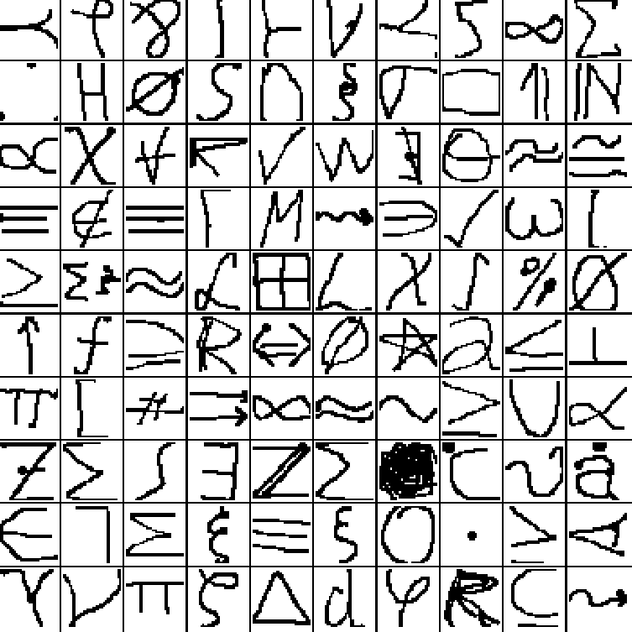
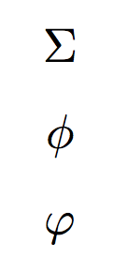
Data acquisition and pre-processing
Database: HASYv2
Thoma, M. (2017) “The HASYv2 dataset”
32x32, black and white images
369 classes
168’233 images
“Two different symbols can have the same glyph” (\sum, \Sigma)
“Two different glyphs can correspond to the same semantic entity” (\phi, \varphi)

Slide 4
Clustering (1)
Preprocessing
Convert image into grayscale, then into binary image
Convert ‘occupied’ pixels into data points
Agglomerative hierarchical clustering
Single linkage
Euclidean distance
Generate bounding box
Subdivide picture for classification
Min/Max coordinates of cluster pixels
Drawbacks
Heavily dependent on preprocessing
Subdivision of connected characters not possible
Detection of characters with seperated regions hard (e.g. i,j,=)

Slide 5
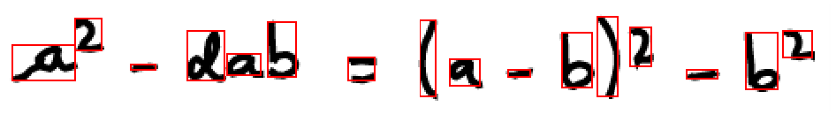
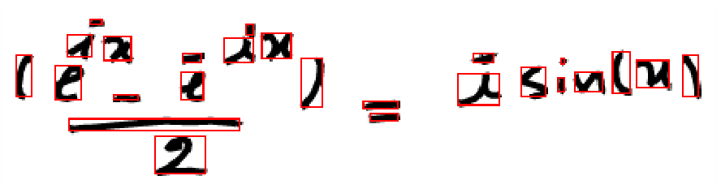
Clustering (2)
K-means and EM Gaussians not suited
Identification of number of cluster centers difficult
Initialization of cluster centres difficult
Combination with hierarchical clustering possible
Improvements in preprocessing data possible

Slide 6
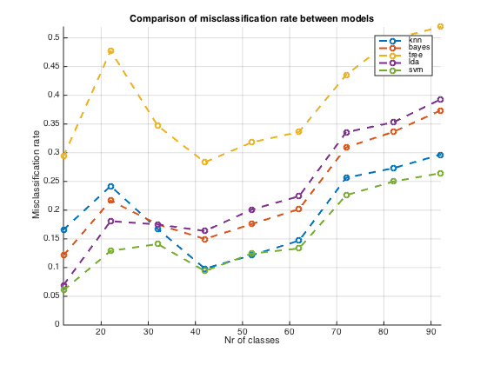
Classification (1)
Shuffle and split data (train-test)
Several models - MATLAB built-ins:
K-nearest neighbours
Classification tree
Naïve Bayes classifier
Linear Discriminant Analysis
… and tries with SVM
Discrepancies in the execution time and misclassification rate

Slide 7
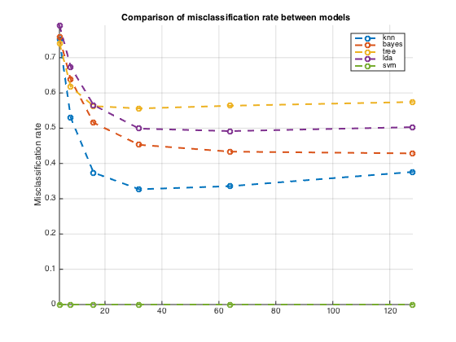
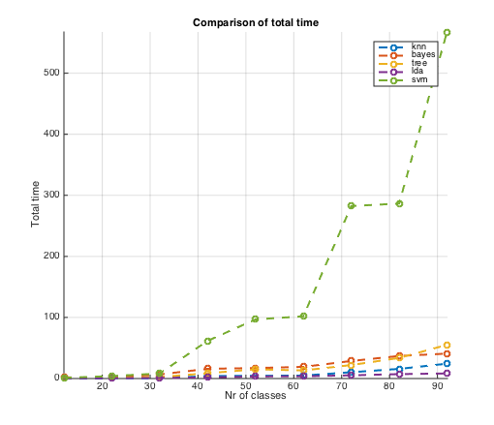
Classification (2)
Overall performance increasing with more dimensions
K-nn shows best performance with 32 to 64 features
Best performance: K-nn with 32 features → error = 32%
Time and memory imprint of SVM are quadratic → impossible with 369 classes

Slide 8
Classification (3) – Neural Nets
Traditional neural network with the Matlab toolbox
Great graphical user interface to supervise the training process
The training process takes a long time (5 hours) using only 20% of the data for training
Achieves a decent error rate around 35% on test data
Convolutional neural networks
Known to perform very well on image data
No need for performing dimensionality reduction
Training using the Keras modul in python is quite fast (1 hour)
On the specified data set we achieved error rates around 25%
Comparable to human accuracy on the data set
Drawbacks
Training process of NNs in general take a long time
Hard to tune the large amount of parameters

Slide 9
Demonstration

Slide 10
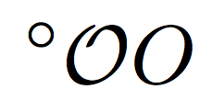
What to do next?
Improve dataset
Remove some fancy symbols
Make a clear difference between different symbols (e.g. degree, \mathcal{O}, O)
Improve models overall
Create grammar for the mathematical language
For example, a formula has to contain a Binary Operator (=, >, <…)
Could help make a difference between close symbols
Create LaTeX output

